Slide 1

Appointment Garnering Practice

Slide 2
Why SaleBuild
Sales Cycles are mostly lengthy, to meet revenue goals it is imperative that sales teams generate more activity and focus on selected valid opportunities, thereby reducing sales cycles – SaleBuild’s offerings make this possible
Ramp up time for new sales teams are excessive as they learn on the job and if they do not have enough activity the corresponding learning curve is longer, sales activity is haphazard and low.
Breaking out into new markets is a struggle based around finding and hiring someone who has relationships in local market, costs of hiring and training are high so you have to insure the success rate on new hires
Direct sales costs are prohibitive and ROI on inside sales is a gamble given US costs, also extensive day to day management is required for a successful program
As a result inside sales is non existent or ignored
No database or limited contact database and the high costs of procuring such a contact list further restricts the efforts of inside sales
Sales and marketing management is focused on direct selling efforts and does not have bandwidth for handholding / training of offshore inside sales team
The SalesBuild product mix becomes a force multiplier allowing these companies to do more with a smaller sales & marketing team.
SaleBuild - Confidential

Slide 3
SaleBuild – Appointment Garnering
  Flat nominal fee of $3,000 per month for a team
    Full time exclusive caller with tech sales experience
    Management Consultant – responsible for creating your program, Reporting Analyst – that provides daily reports
    DBA – to insure that all contacts are utilized
    QA – listens to voice log of every appointment and approves
  Per call agent: 3 – 7 in person appointments weekly
  Proprietary closed loop process including third party survey for your Account Manager to rate the appointment
  Customized emails prior to & after call
  Profiling of customers prior to meeting
    Questions provided by you – need to be close ended
    Once the contact has accepted appointment, caller asks these question “to insure that we only address areas of interest to you”
    Your Account manager can prepare for the call using the info received
    Inputting info into Calendar of AM
  Process to insure that no shows are eliminated:
    Caller will send outlook invite to prospect while on the call with them and request acceptance
    Will dial into the bridge on date of appointment to insure both parties connect
    Will call missing party to join
SaleBuild - Confidential

Slide 4
Value Equation
Reasons why so many start up’s utilize our services:
We can provide and help identify prime targets from our over 1 Million contacts in the US, APAC & EMEA
Appointments Generation – between 15 – 22 - $120 - $150 / appointment in person appointments / month per call consultant
Dramatic reduction in SG&A costs by leveraging telesales for certain products, verticals and or geographies – flat rate, low cost per transaction
Generate brand & product awareness - Increase traffic to website, downloads
Fully loaded cost per month per call consultant is $3000 – no infrastructure, computer or telecom costs that you would have incurred.
SLA based, quality & productivity tracked daily - Zero Management overhead
Our customer Managers consistently rate the quality at 80% or higher
Initial setup methodology is well refined so start up effort and learning curve is compressed
Important business information is captured, appointments inputted into outlook calendar and information into your CRM
SaleBuild - Confidential

Slide 5
Your Possible Goals
Increase revenue growth and capture of new accounts while keeping sales costs low
Do so in a very aggressive time frame
Focus on the US Market and in the future extend into EMEA & APAC
Goals
  Increase rate of capture of new accounts
  Increase revenue quickly while managing costs
  Make existing sales team more productive
  Reduce ramp time of new Account Managers
  Generate product interest - Increase hits on website
  Continue to build Brand Image
SaleBuild - Confidential

Slide 6
What can SaleBuild do for You
Appointment Garnering
  Use SaleBuild Database to segregate prospects
    Verticals
    Geography
    Size – revenue, end users
  Aggressively initiate contact with prospects
  Generate Appointments
    Confirm the following regarding the contact:
      Decision maker
      Confirm interest
      Has a budget
      Other stakeholders
      Has a need
      Relative priority for such an acquisition
    Provide some information on Feature, Benefits, Pricing of product offering
    Capture new contact or other relevant information into database for future use
    Provide information via email
    Confirm receipt of email
Assist with adding additional Channel Partners – cut through the “me too” noise by providing channel with value
  Generate leads for Channel Partners
  Develop success stories & champions based on qualified appointments handed over
SaleBuild - Confidential

Slide 7
Compliment to XYZ's Sales Team
Positive ROI in terms of inside sales efforts
Immediate increase in number of transactions, sales & qualified prospects meets
More targeted lead – continuous increase in conversation rate of meetings to quotes
Increase in New Accounts & New Account Revenue
Reduction in ramp time for new AM’s
Reduced sales cycles – select from a broader set of opportunities, select and focus on more relevant opportunities
Increased market share & brand recognition
SaleBuild - Confidential

Slide 8
How SaleBuild provides Quantifiable, Quality Results.
Our engagement methodology is one of collaboration, scaling methodically and staffing with the best available outside sales talent that is constantly trained & supervised.
Out side Account Managers are converted to Call Consultants. This allows a free flowing conversation rather than a mechanical, disruptive type of call
Results are measured individually and instantly utilizing feedback criteria pre decided on by both parties
Incentives to our Call Consultants are based on matrix’s such as quality, conversion rate of appointments to quotes & orders and not call volume or sheer number of appointments
Constant management oversight – limited number of Call Consultants – 10 - that report into a Managing Consultant whose bonus is linked to customer satisfaction
Random sampling of fixed number of calls monitored on daily basis by Management as silent participants
SaleBuild - Confidential

Slide 9
SaleBuild –The People
Methodology include:
  Training
    Customized training boot camp – collaborative effort
      Reviewing your new hire training, customizing it for prospecting
      Listening in to your most successful prospectors
      PM attending some of your sales calls
  Personnel
    Call Consultants – Appointment Generation – Minimum 1 years experience in outside sales & 2 years in call center environment - Bachelors Degree
    Managing Consultant – 5 + years in management of call centers, 3 + years as sales or operations Managers in non call center environments
    Call Consultants for Virtual Sales– MBA’s or engineers with sales backgrounds
    Component, Migration or Upgrade Sales - SE’s – Engineers with MBA’s
SaleBuild - Confidential

Slide 10
SaleBuild – The Process - Database
1 Million Contacts
Provide & Share
Or Provide
Or Buy
Compare & Extract:
Fortune 1000
Global 500
Channels
Government
Mid Size < $1 B
XYZ's
Database
Master Database for XYZ's Tele Campaign
Productivity Depends on Attacking the Right Target Audience
Without identifying the right audience appointment garnering is just an expensive exercise in meaningless activity
SaleBuild - Confidential

Slide 11
SaleBuild – The Big Picture
Combined Database
Aggressive Calling Weekly Appointments 3-5
Regular Reports Daily, Weekly, Monthly
Methodology
People
Quality Review Daily
Audit Trail - Voice Logs
Processes
Target
Customer
Inserted Appointments
Into AM’s and Sales Management Outlook
Retention of Information
Prospects information can be inputted in CRM
Tools
Immediate increase in
Activity with targeted Prospects – more effective utilization of sales teams
Brand recognition – increased activity helps
Increase in valid forecast and revenue creation
Decreased time to market with new products
Reduced ramp time on new Account Managers
Reduction in cost per sale
SaleBuild - Confidential

Slide 12
SaleBuild – Other Tasks
Enter appointment into Outlook & cc Sales Management
From: Anderson, Jenny
Sent: Friday, April 15, 2005 3:33 PM
To: Anderson, Jenny; Burke, Lynn
Subject: Teleconference : SRI International
When: Monday, May 09, 2005 2:00 PM-2:30 PM (GMT-08:00) Pacific Time (MultiCorp & Canada); Tijuana.
Where: 333 Ravenswood Ave Menlo Park CA 94025
Agent Name: Radha Kumar
Assigned Sales Representative: Tom Noma
Date Of Lead Generation: 04/15/2005
Company Name: SRI International
Contact Name: Johnathan Hammar
Contact Title: IT Director
Contact Ph. Number: 650-859-3663
Contact Email: jhammer@sric-bi.com
Contact Address: 333 Ravenswood Ave Menlo Park CA 94025
Date & Time for Appointment: 05/09/2005 02:00 PM PST Face-to-face or Teleconference: Face to Face
Lead Source/Campaign: SaleBuild - Qualifying Questions:
1) Who is your current service provider? Internal
2) What kind of services are you using? VPN
3) Are you interested in security solutions like Intrusion Prevention Services, Secure Remote Access, or Managed Firewalls? IPS
4) Are you considering VOIP, Video, or cheaper forms of connectivity such as DSL, IPVPNs? VOIP
5) Who monitors your networks and routers 24x7x365? Internal
6) How many locations do you have? Where are they located? 6 Locations Interconnected
7) When does your contract expire? Do you have requirements outside of your existing contract?
8) How do you rate your current provider from 1 - 10, with 10 being best? (Any comments to be included in this section)
9) Do you currently outsource any IT functions? Yes
Enter Prospect information into CRM – no loss of valuable data
SaleBuild - Confidential

Slide 13
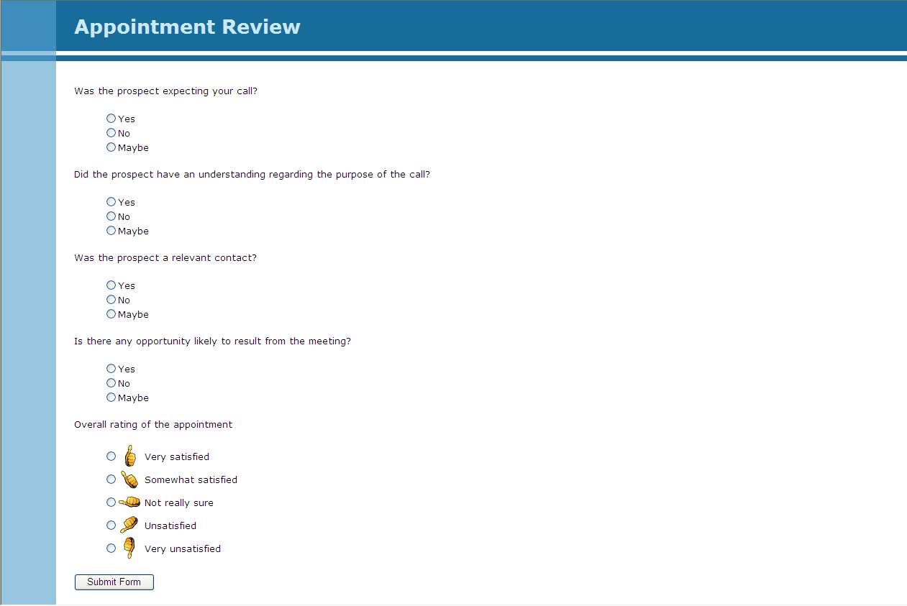
Survey on Every Appointment
SaleBuild - Confidential

Slide 14
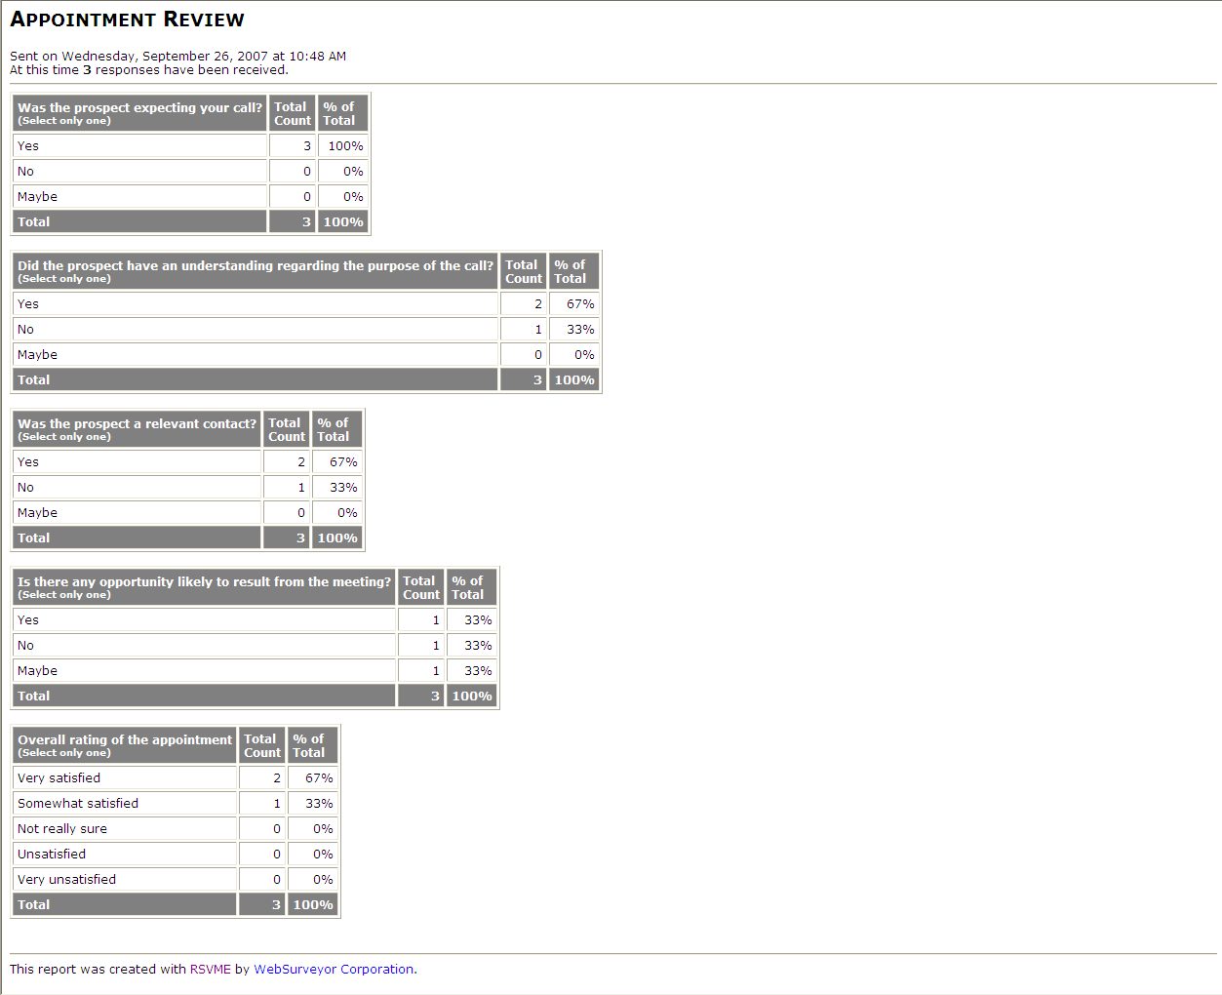
Instant, Immediate Third Party Quality Control - Reports
SaleBuild - Confidential

Slide 15
It's all about revenue generation
Accomplishments
Increased client's annual sales revenue by 430% year over year, recognized as the 19th fastest growing company in Deloitte's Fast 500, only one in its vertical.
Managed new inside sales operations to exceed that of 4 year old inside sales team with over 600% productivity per agent
Reduced cost of inside sales 200% in same period
Number of leads - in person appointments is .5 - 1.25per day per agent
Reduced the sales cycle of an enterprise software product from 9 months to 4 months
Increased the sales pipeline from $350,000 to $5,000,000 in less than 4 months with 5 resources.
Designed and implemented a worldwide sales and pipeline tracking.
Designed and implemented inside sales channel integration with reseller and field sales with negligible channel conflict - attracted new partners due to ability to generate valid leads
Developed call center-specific employee recruiting and incentive methodologies resulting in a "stick" rate of over 95%
SaleBuild - Confidential

Slide 16
Customer Solution
Methodology, Tools, Process, People = Results!
SaleBuild is
ABOUT MAKING A DIFFERENCE – NOT YOUR TYPICAL LEAD GENERATOR! I
A COMPREHENSIVE SOLUTION – YOU CAN LEAVE IT TO US TO DELIVER!
AN ITERATIVE ENGAGEMENT MODEL – WE CUSTOMIZE IT JUST FOR YOU!
ABOUT TRACKING AND PRODUCTIVITY – ANALYSIS BUT NO PARALYSIS! DYNAMIC ADAPTATION OF PROCESS TO EXCEED YOUR NEEDS!!
ABOUT COST SAVINGS – YOU CANNOT IGNORE THE ROI!
SaleBuild - Confidential

Slide 17









You would be in great company!
SaleBuild - Confidential

